Slide 1

SchedIQ
Smart Timetable Manager
Name :
Kamalesh S P
Roll No. :
2116230701138
Department :
Computer Science and Engineering
Subject Code :
CS23621
Subject Name :
Mobile Application Development Laboratory
Flutter · Dart · SQLite · Provider Pattern · Version 2.0 · Android

Slide 2
Abstract
OVERVIEW
Dynamic Timetable Creation
SchedIQ — Smart Timetable Manager is a Flutter-based mobile application designed specifically for academic students who need a reliable, intelligent, and fully offline solution to manage their weekly class schedule and monitor their attendance. The name stands for "Schedule IQ", reflecting the app's intelligent, data-driven approach to academic time management.
Students build their weekly schedule day by day. The system validates every new entry against existing slots and blocks any time conflict before it is saved to the database.
Attendance Tracking & Alerts
DEVELOPMENT HISTORY
Every class entry carries an attendance record. The app calculates a live percentage per subject and displays colour-coded warning or danger alerts when the percentage falls below student-defined thresholds.
SchedIQ was developed in two phases. Version 1 served as the foundational prototype, offering a basic hardcoded weekly timetable with simple add/delete functionality and a single SQLite-backed provider. Version 2 — presented here — is a complete production-ready upgrade introducing smart overlap detection, real-time attendance tracking with configurable alert thresholds, PDF export in the university-standard format, dark mode, student onboarding, holiday management, and a 45-day semester lifecycle automation system.
PDF Export
A single tap generates a university-format landscape PDF with a 9-period time grid, working day rows, and a subject legend table — ready to print or share.
TECHNICAL STACK
Platform: Android · Framework: Flutter (Dart) · Database: SQLite via sqflite · State: Provider Pattern (6 providers) · PDF: pdf + printing plugins · Config: shared_preferences · Alerts: flutter_local_notifications
Smart Notifications & Offline
Local notifications remind students of upcoming classes. The entire application — scheduling, attendance, PDF, notifications — functions with zero internet connectivity and no user account.

Slide 3
Problem Statement
Every semester, students across engineering institutions receive their class timetable in the form of a printed sheet or a shared Excel file. While this approach has existed for decades, it is fundamentally ill-suited for the dynamic, mobile-first academic environment of today. Students are expected to self-manage their schedule, track their own attendance, and submit formatted timetables to faculty — all without any intelligent digital assistance.
01
Absence of Conflict Detection
02
No Attendance Visibility Until It Is Too Late
When students manually enter their schedule into a diary, calendar, or generic app, there is no mechanism to detect whether two classes have been booked at the same time slot. Such conflicts go unnoticed until the day itself, causing last-minute confusion and scheduling errors.
Most institutions require a minimum of 75% attendance per subject to be eligible for examinations. However, students have no real-time view of their running attendance percentage per class. They often discover a shortfall only in the final weeks of the semester, leaving no time for correction.
03
Manual and Tedious Semester Transitions
04
No Standardised PDF Export for Submission
At the end of every semester, the entire timetable becomes obsolete. Students must manually delete each class entry one by one from whatever tool they are using. There is no intelligent mechanism that recognises a semester has ended and offers a bulk reset for the new cycle.
When students or class representatives are required to submit the timetable in the institution's standard 9-period grid format, they must manually recreate it in Excel or Word. This is time-consuming, repetitive, and error-prone — especially when the schedule changes mid-semester.

Slide 4
Real-World Problem Description
The following scenarios illustrate concretely how the identified problems manifest in real academic life and how SchedIQ resolves each one.
Scenario A — The Overlap Problem
Scenario B — The Attendance Crisis
Ravi books Data Structures at 10:00 AM and accidentally adds Operating Systems to the same 10:00 AM slot on Monday. Without a conflict checker, both entries coexist silently in the schedule. SchedIQ prevents this by querying all existing entries for the same day and time range before saving — blocking the duplicate and surfacing a descriptive error message to the student.
Priya has attended 27 of her 40 scheduled DBMS classes, placing her attendance at 67.5% — well below the mandatory 75%. She only discovers this when checking the official university portal in Week 14, with insufficient time remaining to recover. SchedIQ recalculates the attendance percentage after every mark and displays a colour-coded Danger alert the moment the threshold is breached, giving Priya an opportunity to act early.
Scenario C — The Semester Transition
Scenario D — The PDF Submission
When a new semester begins in June, a student opens their scheduling app to find 30+ stale class entries from the previous semester. Deleting them one by one is tedious and prone to error. SchedIQ automatically tracks the date the timetable was first created. After 45 days, it prompts the user to clear all data in a single action, with an option to defer the reset by 7 days if the new semester has not yet commenced.
The Class Representative is asked by the Head of Department to submit the departmental timetable in the official 9-period landscape grid format. Ordinarily, this would require opening Excel, manually formatting the grid, and printing it. With SchedIQ, the CR taps Export PDF, and within seconds receives a properly formatted A4 landscape document — complete with day rows, nine time-slot columns from 8:00 AM to 4:50 PM, a Lunch column, and a subject legend table — ready to share via WhatsApp, email, or print.

Slide 5
Existing System / Model
Before designing SchedIQ, a survey of tools currently used by students was conducted to understand their limitations and identify the gap this application must fill.
Tool | Limitation | Sched. | Attend. | PDF | Notif. | Offline
Google Calendar | General-purpose; no academic context, no attendance tracking, requires internet and Google account. | ✔ | ✘ | ✘ | ✔ | ✘
Paper Timetable | Cannot detect overlaps, calculate attendance, send notifications, or produce a digital export. | ✔ | ✘ | ✘ | ✘ | ✔
Excel / Google Sheets | No mobile interactivity, no notifications, no attendance logic, manual formatting required. | ✔ | ✘ | ✔ | ✘ | ✔
Reminder / To-Do Apps | Not linked to a structured timetable; no conflict detection, no attendance tracking, no PDF. | ✘ | ✘ | ✘ | ✔ | ✔
University ERP Portals | Read-only departmental view; no personal customisation, real-time attendance, or export capability. | ✔ | ✔ | ✘ | ✘ | ✘
SchedIQ ✦ | Dedicated offline-first academic tool combining all five capabilities in one application. | ✔ | ✔ | ✔ | ✔ | ✔

Slide 6
Proposed System / Model
UI Layer
State Management Layer
The interface is built on Flutter's Material 3 design system and supports both light and dark themes. Key screens include: Onboarding (first launch only), Home (today's timetable), full week Timetable view, Add/Edit Class form, Attendance summary, Settings, Holiday manager, and an About screen.
Six Provider classes manage reactive application state: TimetableProvider handles V1-compatible class entries; AppProvider orchestrates all data loads at startup; SubjectProvider manages the subject master list; AttendanceProvider computes per-subject percentages; HolidayProvider tracks non-working days; and SettingsProvider persists dark mode, working days, attendance thresholds, and the 45-day semester timestamp.
▶
Data Layer — SQLite via sqflite
Service Layer
DatabaseHelperV2 maintains a relational schema with four tables: class_entries (day, time, subject, location, faculty), subjects (code, name, faculty), attendance_records (linked to class entries), and day_statuses (holiday or working-day flags). A RegEx-based fallback parser ensures backward-compatible reading of legacy V1 time strings.
Three dedicated service classes sit beneath the database: NotificationServiceV2 schedules and reschedules class reminders using flutter_local_notifications; PdfService uses the pdf and printing plugins to generate the 9-slot landscape academic grid; and PreferencesService wraps shared_preferences for all persistent configuration. The entire stack operates fully offline with no cloud dependency whatsoever.
▶

Slide 7
Research Gap
A literature survey of existing mobile scheduling and attendance tools reveals five distinct and unaddressed gaps that motivated the development of SchedIQ.
Gap 1
No Unified Academic Scheduling Solution
Gap 4
Fixed and Non-Configurable Attendance Thresholds
Existing mobile applications handle either scheduling or attendance tracking in isolation, but none integrates both with smart conflict detection, configurable attendance thresholds, and PDF export into a single lightweight offline tool designed for engineering students.
Attendance tracking in comparable tools uses a universally fixed threshold (typically 75%). No application offers independently configurable Warning and Danger thresholds per student or institution, limiting adaptability to varying academic attendance policies across institutions.
Gap 2
Cloud Dependency in Comparable Apps
Gap 5
No Standardised University-Format PDF Export
The majority of modern scheduling applications require cloud connectivity, a user account, or both. This creates a critical barrier for students in low-connectivity environments. No prior offline-first academic scheduling app with this feature set exists in the open-source ecosystem.
The automated generation of a 9-slot landscape timetable PDF — matching the exact period-by-day grid format used in Indian engineering institutions, complete with a subject legend table — has not been implemented in any comparable open-source academic scheduling tool prior to SchedIQ.
Gap 3
Absence of Semester Lifecycle Automation
No published academic scheduling tool incorporates automated semester transition detection. The 45-day lifecycle check — which measures time elapsed since timetable creation and prompts a controlled bulk data reset — is an original contribution of this project.

Slide 8
Novelty of the Project
SchedIQ introduces seven original contributions that distinguish it from any existing academic scheduling tool.
1
Smart Overlap Detection Engine
5
Dynamic Working Day Configuration
On every save action, the system queries all existing class entries for the same day and checks whether the new entry's start–end window conflicts with any existing slot. If a conflict is found, the save operation is blocked and a descriptive error is shown — preventing impossible schedules from ever entering the database.
Students configure their institution's active days (Mon–Sat or any subset) in Settings. Disabled days are immediately removed from timetable tabs, class-addition dropdowns, and the PDF export — ensuring the entire application adapts to the institution's academic calendar without manual workarounds.
2
Dual-Threshold Configurable Attendance Alerts
The attendance tracker maintains two independently configurable thresholds: Warning and Danger. After every attendance mark, the running percentage is recalculated and compared against both thresholds. A yellow indicator appears below Warning level; a red indicator appears below Danger level — giving students immediate, actionable visibility.
Dual-Architecture V1 + V2 Backward Compatibility
6
Both V1 and V2 providers are registered and run in parallel at application startup. V1 class entries remain fully readable and manageable by the V1 provider while all V2 features operate alongside them. This demonstrates a professional approach to incremental software evolution without requiring data migration or breaking existing records.
3
45-Day Semester Lifecycle Automation
When the app is first configured, the current date is stored as the timetable creation timestamp. On every subsequent launch, the background checker calculates elapsed days. At 45 days, a dialog prompts the student to clear all class and attendance data for the new semester. A 7-day deferral option is offered for students whose semester has not yet transitioned.
7
Fully Offline, Zero-Login Architecture
University-Standard 9-Slot Landscape PDF Export
Every capability — timetable management, attendance tracking, PDF generation, and local notifications — functions entirely without an internet connection, a remote server, or a user account. This is a deliberate architectural decision ensuring the application remains accessible to all students regardless of their device data plan or network environment.
4
The PDF engine constructs a structured A4 landscape document with 9 time-slot columns (8:00 AM to 4:50 PM), a Lunch column, one row per working day, and a subject legend table. The file can be shared via WhatsApp, email, or saved to Downloads instantly.

Slide 9
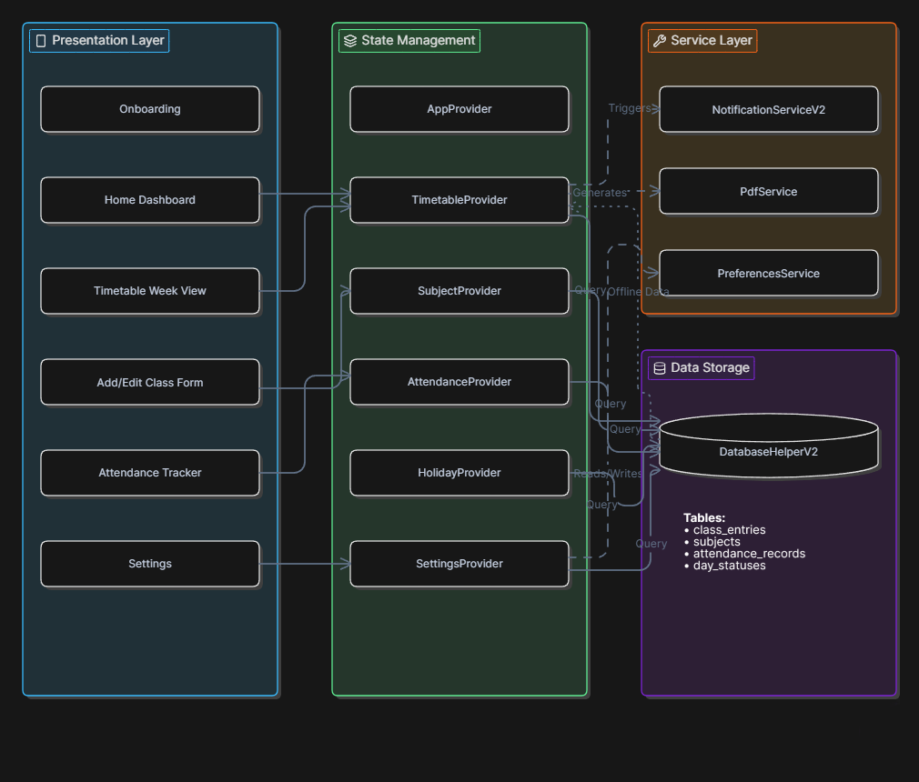
Architecture Diagram of the Project
SchedIQ architecture diagram:
1
2
3
4

Slide 10
Novelty of the Project
SchedIQ introduces seven original contributions that distinguish it from any existing academic scheduling tool.
1
Smart Overlap Detection Engine
5
Dynamic Working Day Configuration
On every save action, the system queries all existing class entries for the same day and checks whether the new entry's start–end window conflicts with any existing slot. If a conflict is found, the save operation is blocked and a descriptive error is shown — preventing impossible schedules from ever entering the database.
Students configure their institution's active days (Mon–Sat or any subset) in Settings. Disabled days are immediately removed from timetable tabs, class-addition dropdowns, and the PDF export — ensuring the entire application adapts to the institution's academic calendar without manual workarounds.
2
Dual-Threshold Configurable Attendance Alerts
The attendance tracker maintains two independently configurable thresholds: Warning and Danger. After every attendance mark, the running percentage is recalculated and compared against both thresholds. A yellow indicator appears below Warning level; a red indicator appears below Danger level — giving students immediate, actionable visibility.
Dual-Architecture V1 + V2 Backward Compatibility
6
Both V1 and V2 providers are registered and run in parallel at application startup. V1 class entries remain fully readable and manageable by the V1 provider while all V2 features operate alongside them. This demonstrates a professional approach to incremental software evolution without requiring data migration or breaking existing records.
3
45-Day Semester Lifecycle Automation
When the app is first configured, the current date is stored as the timetable creation timestamp. On every subsequent launch, the background checker calculates elapsed days. At 45 days, a dialog prompts the student to clear all class and attendance data for the new semester. A 7-day deferral option is offered for students whose semester has not yet transitioned.
7
Fully Offline, Zero-Login Architecture
University-Standard 9-Slot Landscape PDF Export
Every capability — timetable management, attendance tracking, PDF generation, and local notifications — functions entirely without an internet connection, a remote server, or a user account. This is a deliberate architectural decision ensuring the application remains accessible to all students regardless of their device data plan or network environment.
4
The PDF engine constructs a structured A4 landscape document with 9 time-slot columns (8:00 AM to 4:50 PM), a Lunch column, one row per working day, and a subject legend table. The file can be shared via WhatsApp, email, or saved to Downloads instantly.

Slide 11
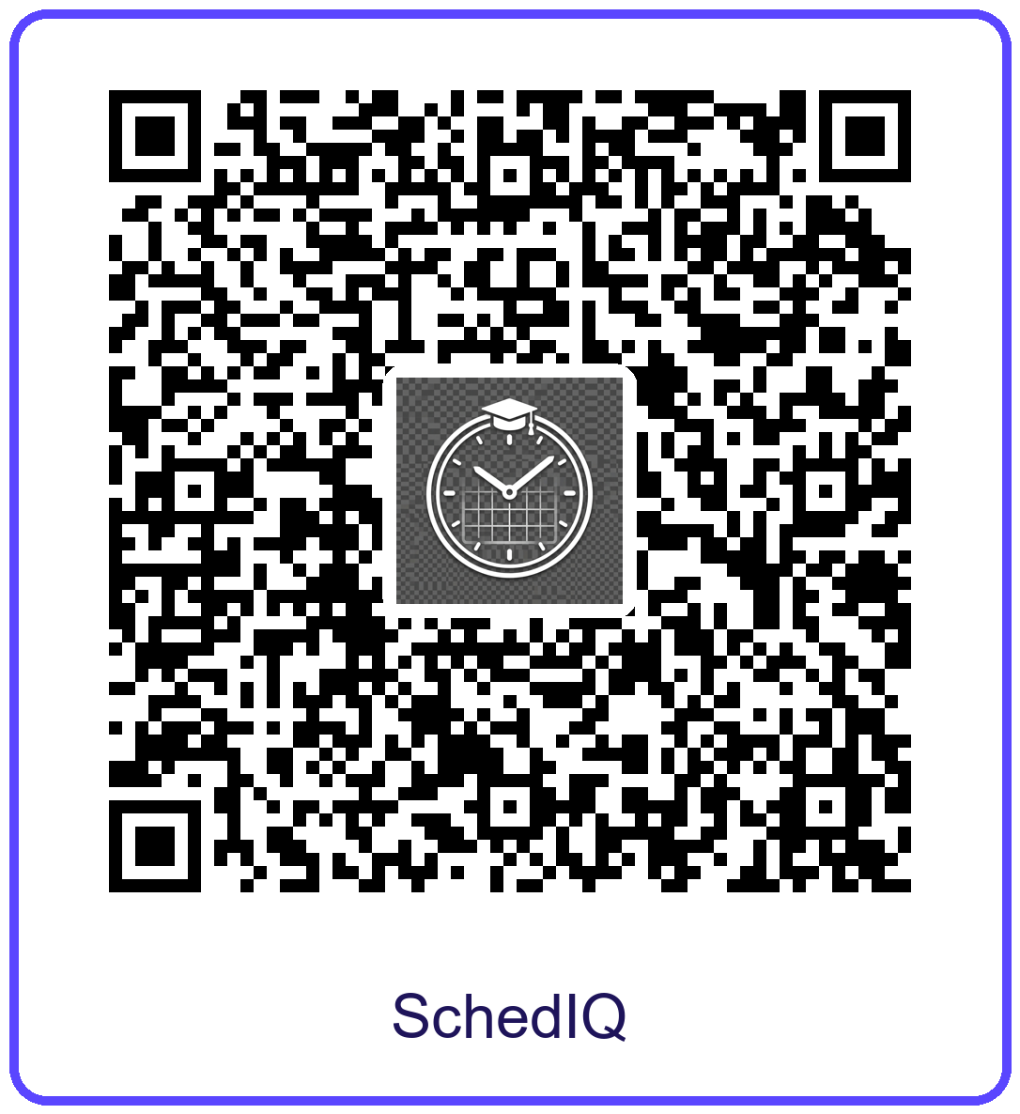
QR Code to Download this Application
Scan the below QR to download this Application:
1
2
3
4

Slide 12
Project Demonstration
The following walkthrough describes the complete user journey through SchedIQ from first launch to semester-end reset.
Step 1 — Launch & Onboarding
1
On first launch, a sleek onboarding screen guides the student through the app's capabilities. It appears once only. Tapping Get Started initialises all six data providers and loads the main shell.
Step 2 — Dashboard / Home Screen
Step 5 — Exporting the Timetable as PDF
2
5
The home screen automatically displays the timetable for the current day. A tab bar lists abbreviated day names with a dot indicator on today's tab. If no classes have been added, a friendly empty-state prompt is shown with instructions.
The student taps Export PDF. The PDF Service queries all entries, constructs the 9-slot landscape A4 grid, and produces the document. The student may save it to Downloads or share it instantly through the native OS share sheet.
Step 3 — Adding a New Class
Step 6 — Settings & Configuration
3
6
The student taps Add Class and fills in the subject, day, start time, end time, and room. On Save, the overlap engine queries the database. If the slot is free the entry is saved; if a conflict is detected, the form shows an error and the entry is not saved.
The Settings screen provides control over dark mode, active working days, Warning and Danger attendance thresholds, the subject master list, and declared holidays — allowing the app to adapt fully to each student's institutional context.
Step 4 — Marking Attendance
Step 7 — 45-Day Semester Reset Prompt
4
7
After each class, the student marks Present or Absent. The Attendance screen immediately recalculates the running percentage per subject. If it drops below the Warning threshold a yellow alert appears; below Danger a red alert is shown.
After 45 days of use, the next app launch triggers a dialog: A new semester may have started — Clear all data? The student may reset everything for the new semester, defer the prompt by 7 days, or dismiss it entirely without any data loss.
SchedIQ — Production-ready · Offline-First · Intelligent Academic Scheduling

